Slide 1
Dominion in Perun app channel
Group 6 - Tim Fischer, Till Müßig, Christian Franck

Slide 2
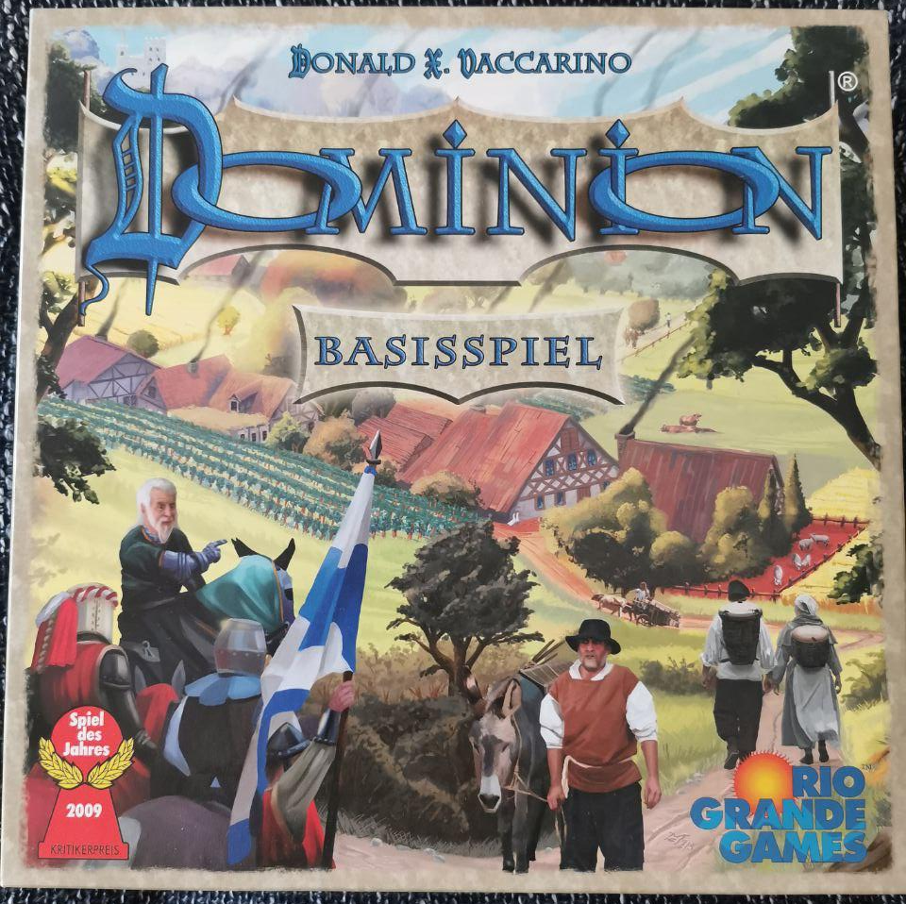
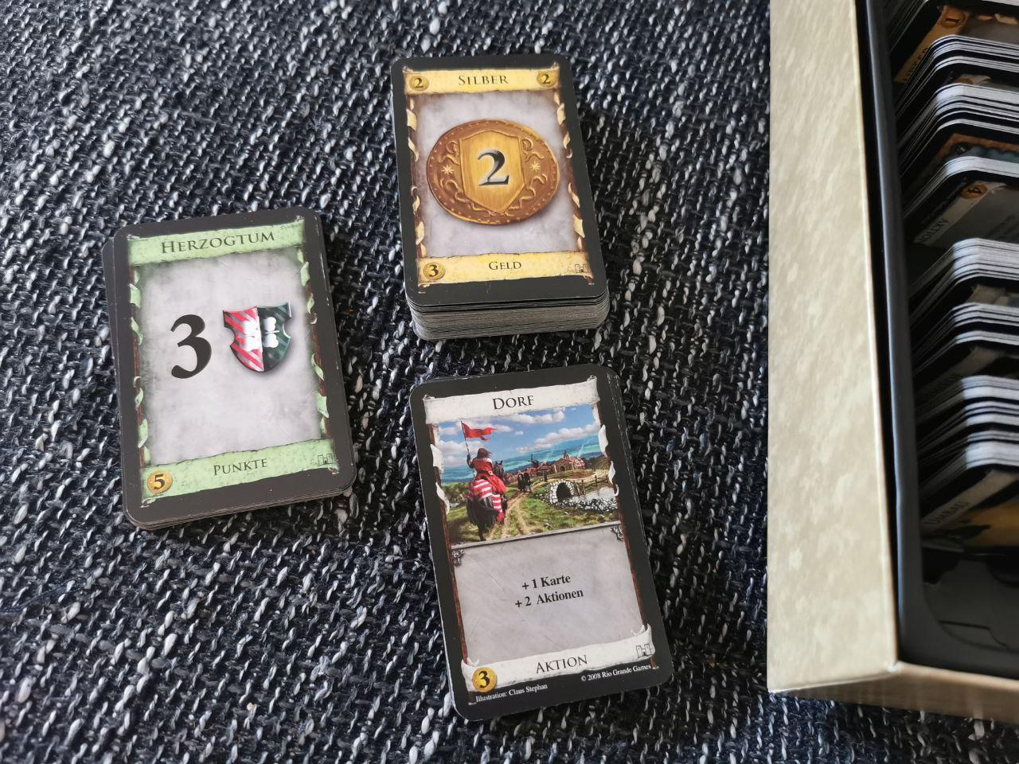
The Game
Each player draws and activates cards in order to generate money, which can be used to buy better cards and victory points.

Slide 3
Technical Challenges
Basic mechanism & rules
Cards
Randomness
Hidden cards
UX - web3 dApp
Cards as NFT

